Slide 1
CONNECT 4
PREPARED BY:
Jarrod X. BANKS, SYEDA NOWREEN, ASMINA AKRAM,
SUDESHNA BHATTACHARYA, MICAHEL FLATLEY

Slide 2
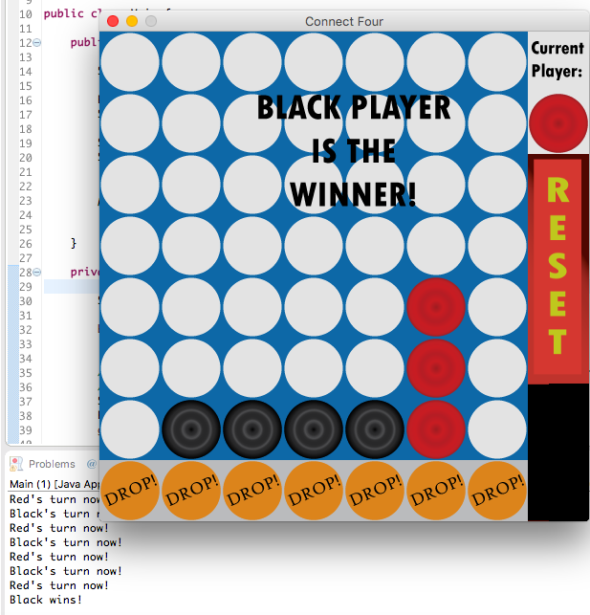
INTRODUCTION
Puzzle one/two player game.
Each player drops the checker alternatively.
Connect four discs of the same color horizontally, vertically and diagonally.

Slide 3
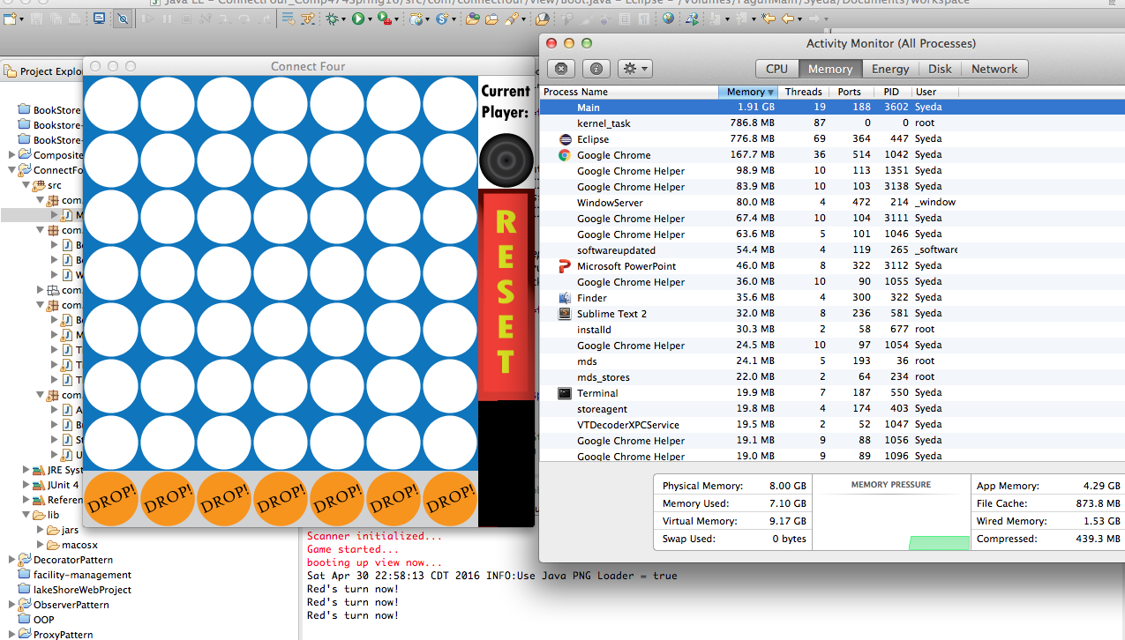
TECHNICAL BARRIERS
Memory leakage

Slide 4
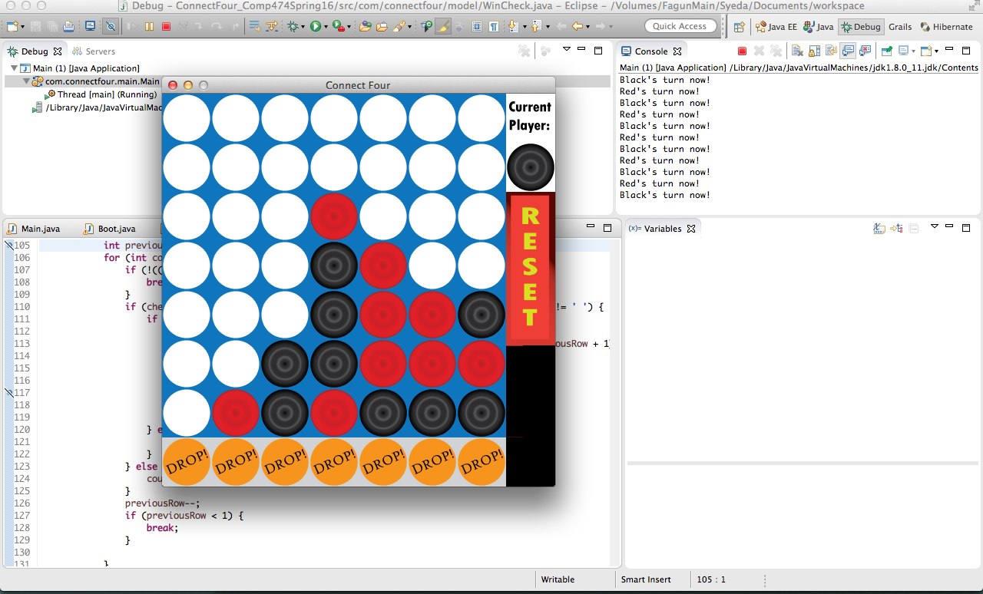
2) Functionality Error

Slide 5
3) Display Flickering
Tried to solve memory leakage, but display flickering starts.
4) Reset Button not working

Slide 6
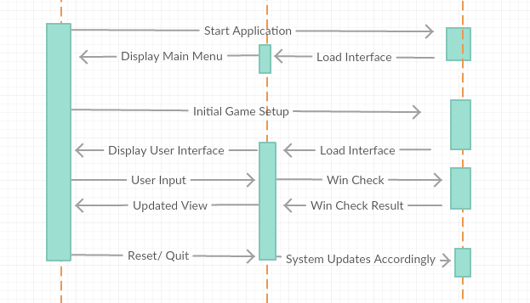
Sequence DIAGRAM

Slide 7
TESTING

Slide 8
SYSTEM CONFIGURATIONS
JAVA
ECLIPSE IDE
GRAPHICAL USER INTERFACE – LWJGL

Slide 9
FUNCTIONAL REQUIREMENTS
Starting the game
Place a checker in the board
Fine winner by checking horizontally, vertically & diagonally
Adding Reset option
Switching between players
Illegal moves

Slide 10
FUNCTIONAL REQUIREMENTS
Board Display
Menu Display
Testing User Services
Adding buttons in the menu bar
Ending the game
Easy mode AI
Hard mode AI – Not implemented yet

Slide 11
Non Functional requirements
The average latency needs to be less than 50 millisecond for swapping the player.
The system shall be stable.
Unit test coverage should be more than 80%.

Slide 12
Sprint 2
Improvement in GUI –
Added buttons
Code Cleanup
Fixed bugs (Display flickering, memory leakage)
Implemented Easy AI
Completed the documentation.

